Slide 1
smartmail & smartportal: Introducing Two-Factor Authentication
Presented By:
Business Process Team
DL-BusinessProcessandAutomation@fnf.com

Slide 2
Why introduce Two-Factor Authentication?
Decision of the Organization to protect our clients and customers further by adding another layer of security.
Current FBI Fraud Statistics for Real Estate Transactions:
In 2016:
$19 Million successfully diverted
In 2017:
$969 Million diverted or attempted to be diverted
Potential increase of $950 Million!!!

Slide 3
What is Two Factor Authentication?
Additional layer of security used in many online platforms today.
Requires not only a Username and Password, but also something that only that user has in their possession.
Using Two Factor Authentication makes it harder for potential fraudsters to gain access to that person’s personal data and information.

Slide 4
How Two Factor Authentication works in smartportal
Smartmail sent requiring Two Factor Authentication.
Customer receives smartmail and clicks View smartmail link.
Customer logs in to smartportal with Username and Password.
New users must still complete the New User Registration.
Customer receives text message with 6-digit code.
Customer enters code on the smartportal screen.
Customer accesses smartmail message.

Slide 5
Recipient View: Accessing smartmail with Two-Factor Authentication

Slide 6
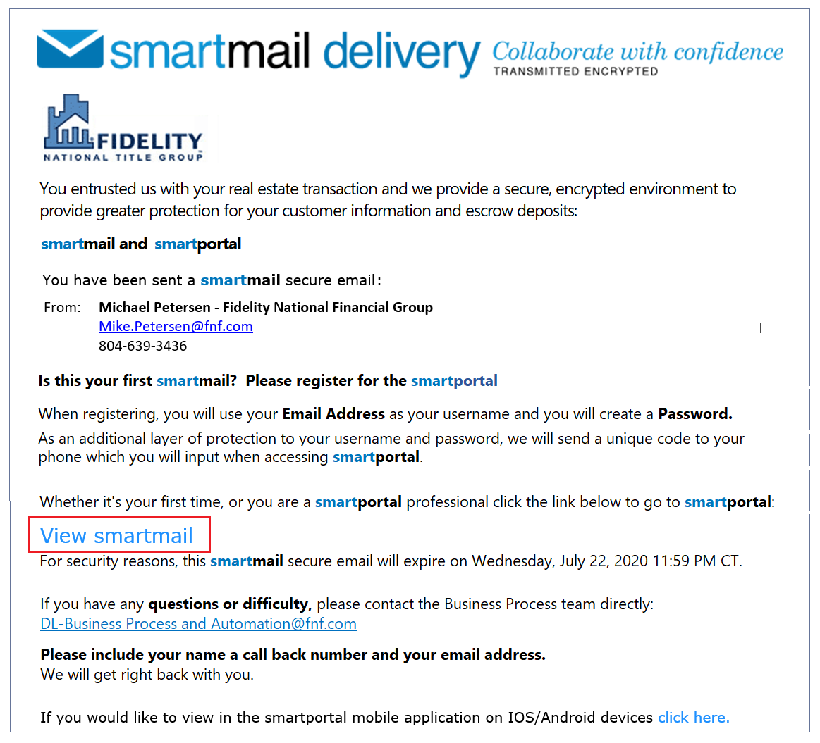
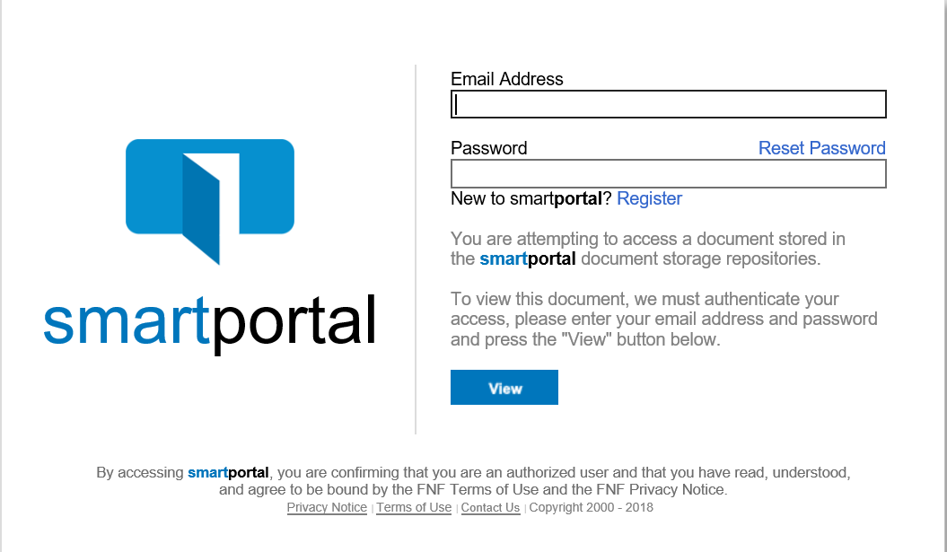
Initial Delivery
All Recipient Registration and Login rules and requirements still apply.

Slide 7
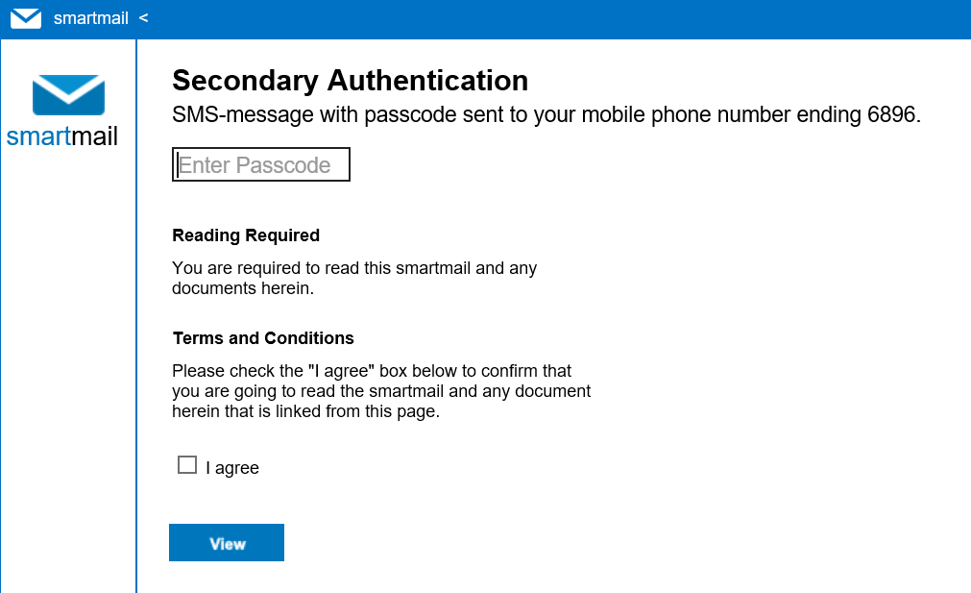
Two Factor Authentication with Mobile Phone Listed
PIN Code sent to their Mobile Phone as soon as the login is successful.

Slide 8
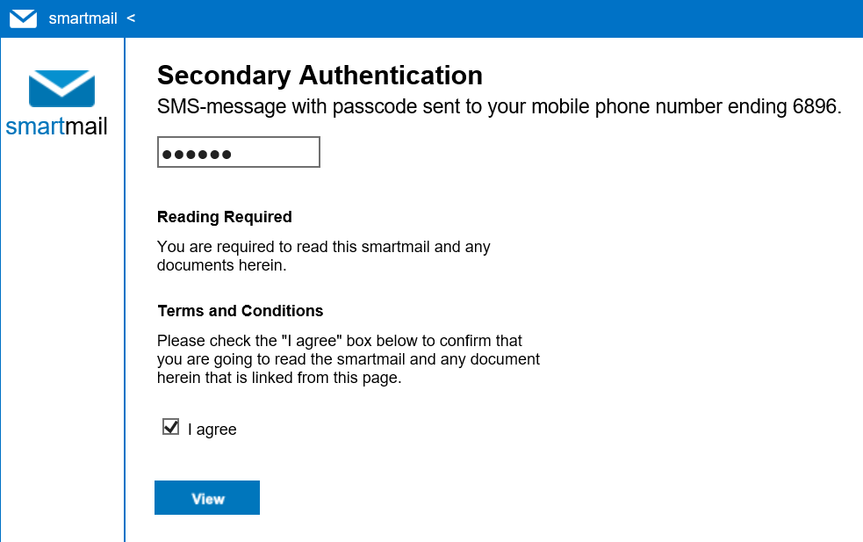
Two Factor Authentication Completed

Slide 9
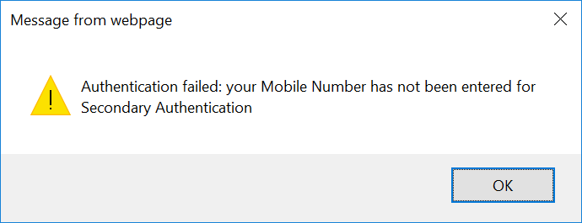
Two Factor Authentication without Mobile Phone Listed
If a Recipient receives this message, a Mobile Phone Number was not listed when they received their first smartmail delivery.
The Recipient can update their smartportal User Profile to add their Mobile Phone Number.

Slide 10
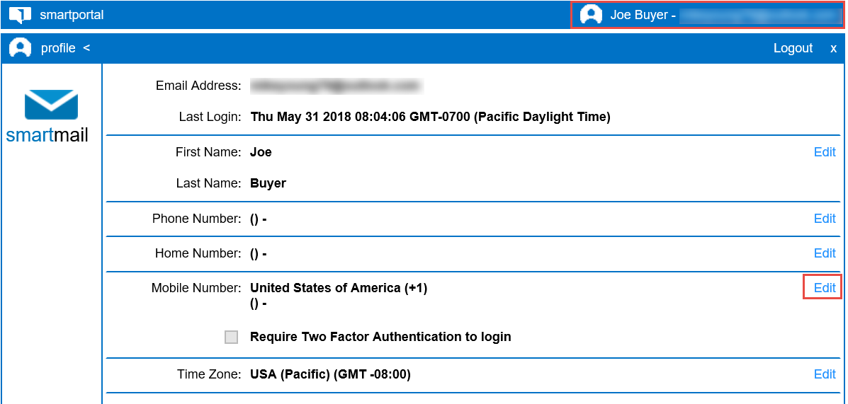
Updating smartportal User Profile

Slide 11
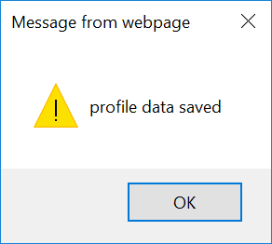
Updating smartportal User Profile
This is a one-time update in each recipient’s account, for all Two Factor Authentication requests.

Slide 12
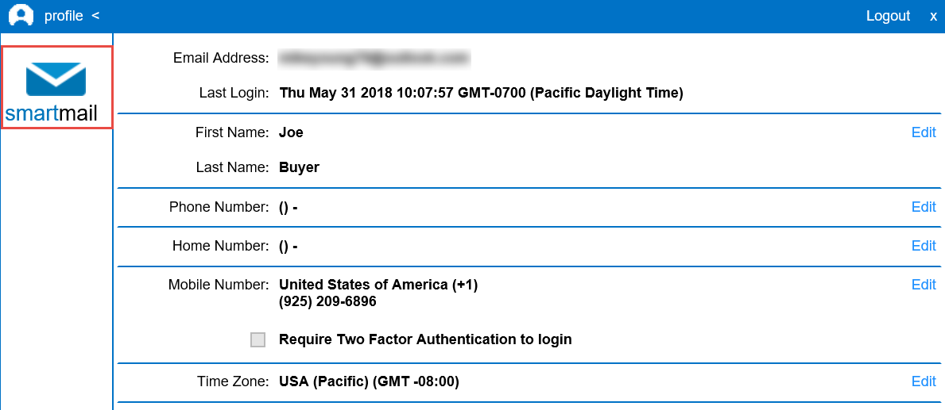
Profile Update Completed

Slide 13
Two Factor Authentication with Mobile Phone Listed
PIN Code sent to their Mobile Phone as soon as the login is successful.

Slide 14
Two Factor Authentication Completed

Slide 15
Two-Factor Usage
Designed to be used in ALL Communications.
Any distribution where the email and/or document(s) contain:
Wire Instructions
Personal / non-public information
Financial Information

Slide 16
Thank You!!
Questions?
Please Contact:
DL-BusinessProcessandAutomation@fnf.com

